Slide 1
Walter Hop
Web-shop Order Prediction Using Machine Learning
Master’s Thesis
Computational Economics

Slide 2

Background
E-commerce is displacing physical stores
Maximize customer interest/turnover
Physical store
  Human contact with customers
  Expert advice
Web shop
  Customize web shop experience
  Big spender: Upselling, package deals
  Small spender: Discounts
  But who is who?

Slide 3
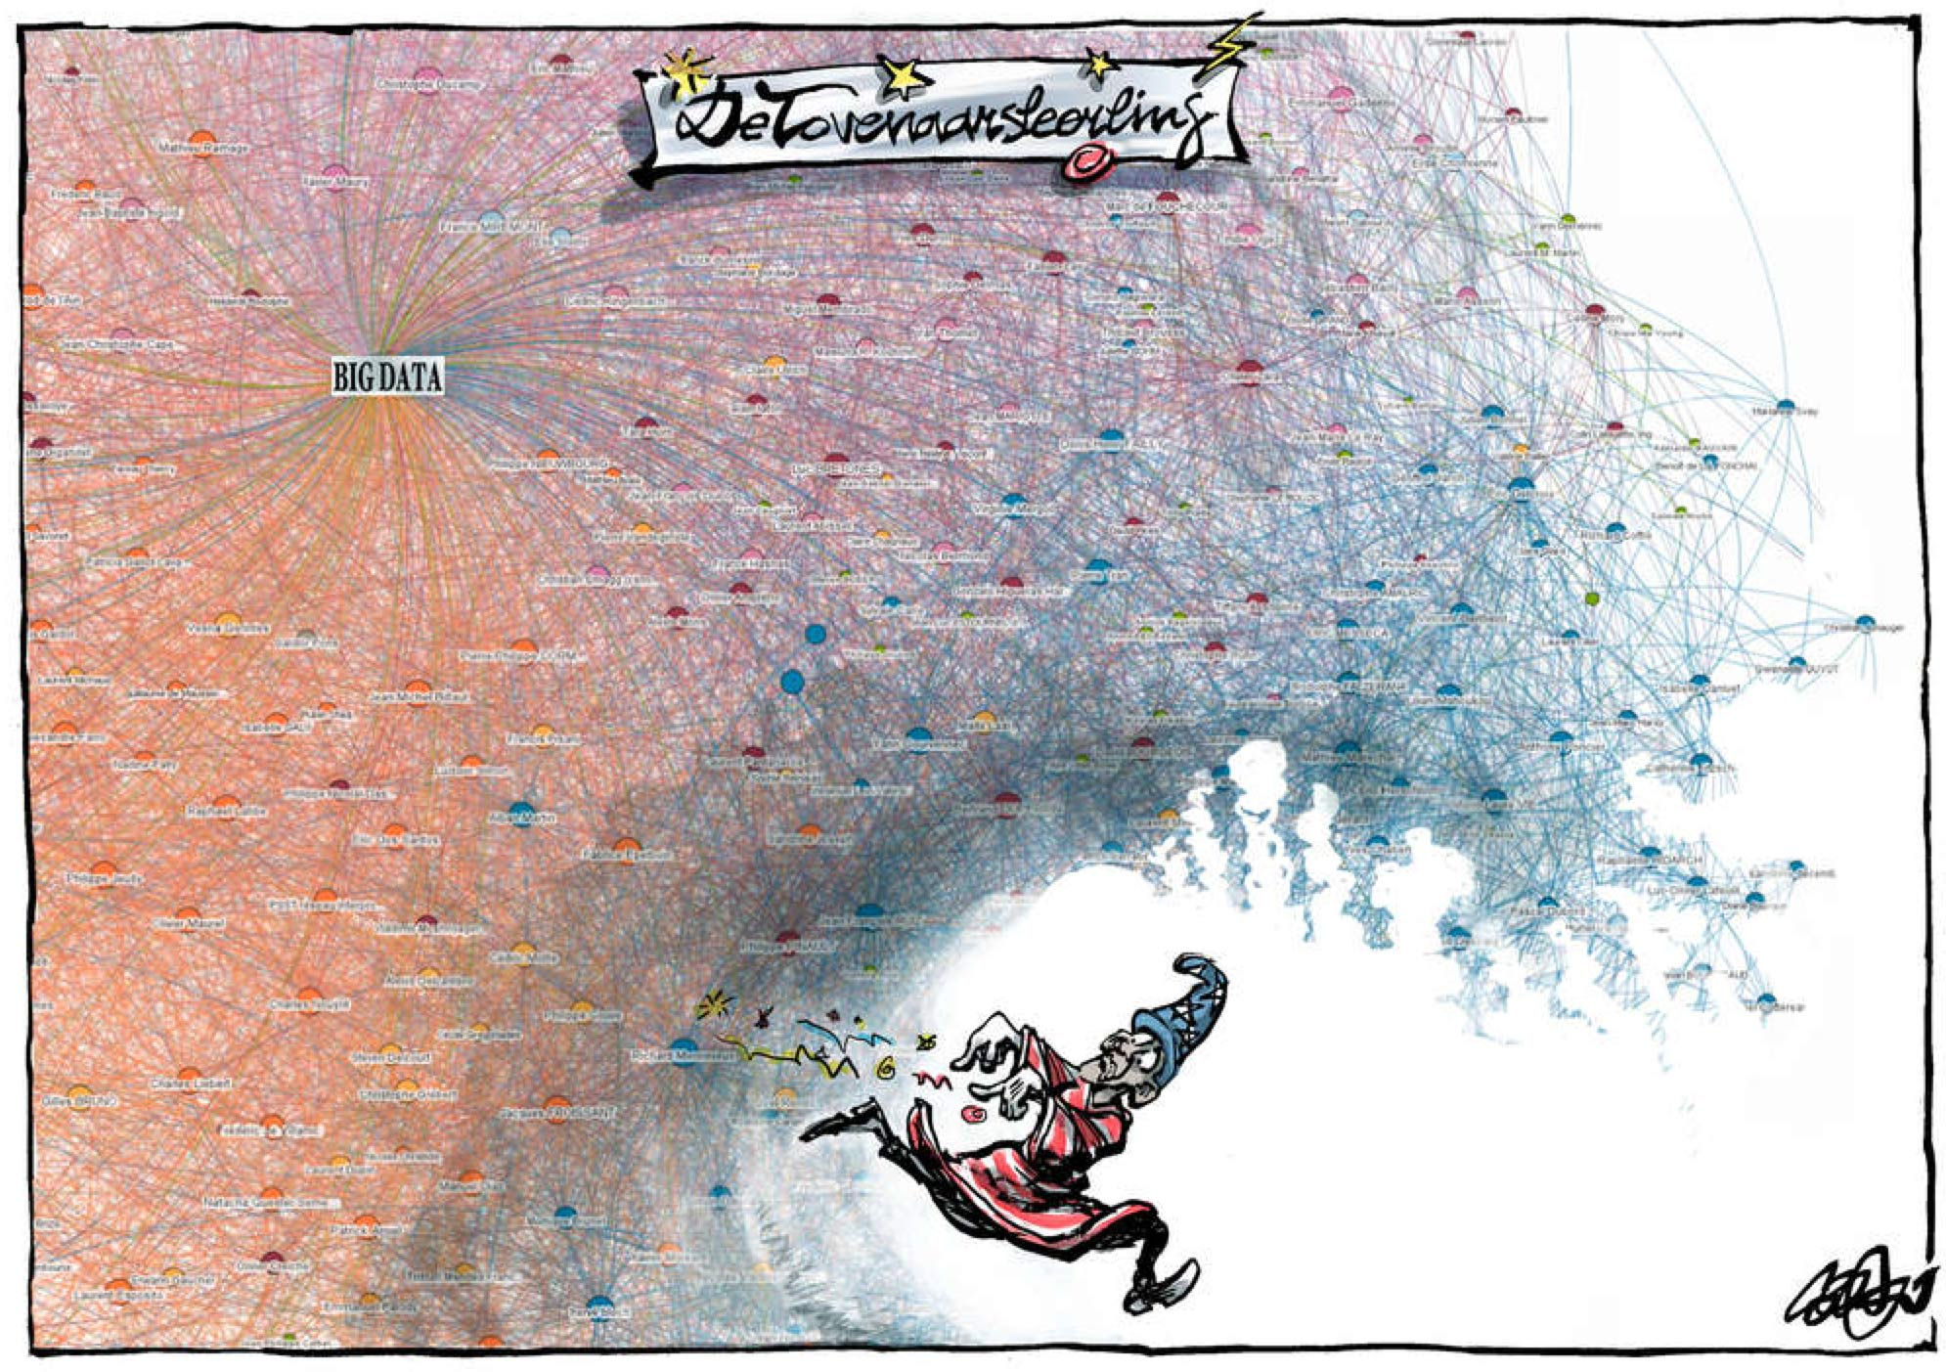
De Volkskrant, 27 aug 2013

Slide 4
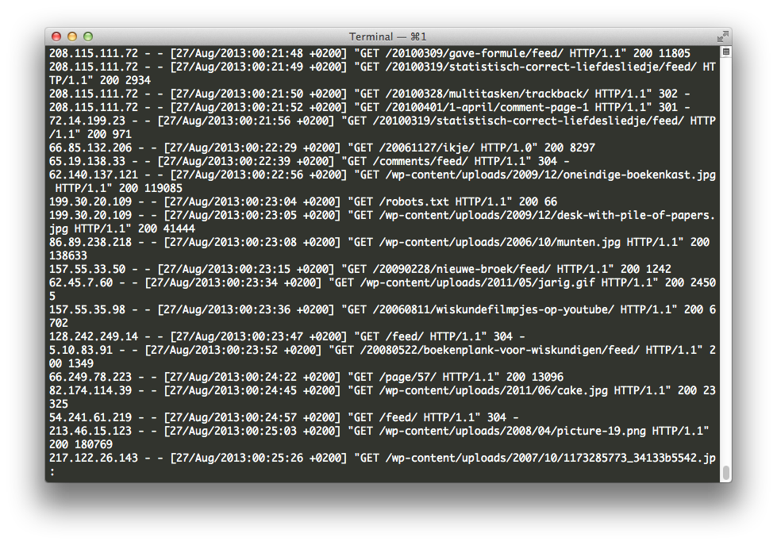

Data mining
Text
Webserver log files
Customer database (CRM)
400,000 transactions by customers

Slide 5
Data mining
24 attributes known of a customer transaction:
day and time
maximum price of products viewed
price of products put in shopping basket
stock levels of products
customer age, gender, # past orders
step in order process
etc…
Many transactions have some missing data

Slide 6

Research problem
Order prediction:
Will the customer place
an order during this
website visit?
Which algorithm can best predict order probability, based on transaction data?
How to deal with missing data?
Can we improve predictions by combining prediction algorithms?
Train/test data: DMC 2013

Slide 7
Feature extraction
Derive variables for a user session (visit) from all component transactions
Use aggregation operators
average: e.g. average price of products
count: e.g. number of transactions
sum: e.g. total time spent browsing the site
standard deviation: e.g. similarity of prices
etc…
62 features

Slide 8
Handling missing data (56%)
Exclude incomplete sessions from analysis
Imputation: replace missing value by a new generated value
  Mean imputation
  Predictive imputation
  Unique-value imputation: use an extreme value, such as –1
Imputation: No difference in prediction
Prefer simple imputation: unique-value

Slide 9
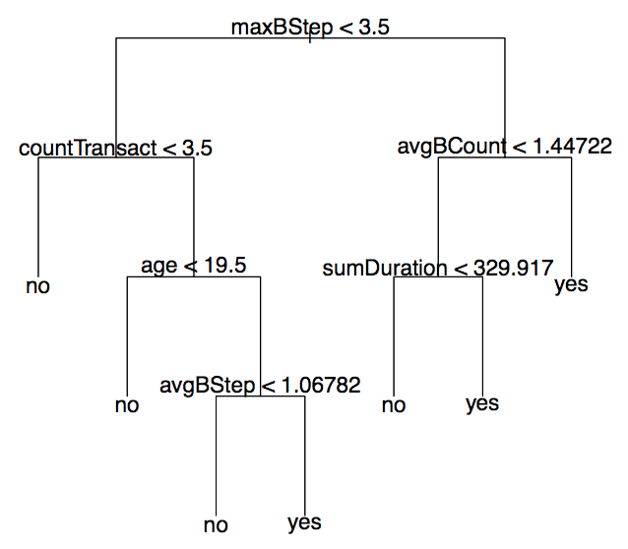
Prediction algorithms
Random Forest
500 decision trees
Trees are diverse
  Bootstrapping
  Only look at some
  variables
+ Very fast
+ Few parameters to set
+ Internal error estimate

Slide 10
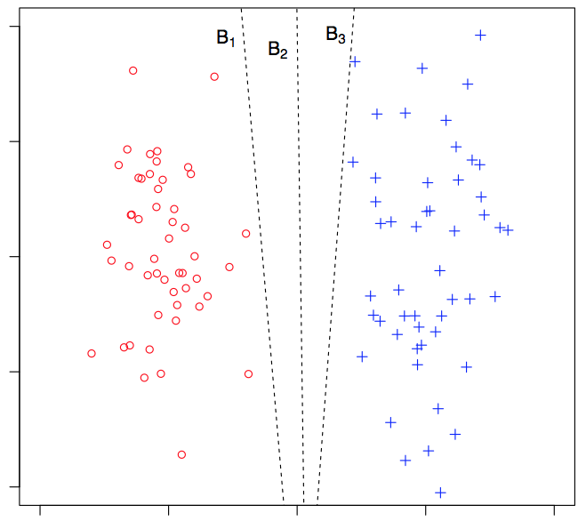
Prediction algorithms
Support Vector Machine
Numerical optimization
Finds best separating
hyperplane in
high-dimensional space
+ Recognizes complex
patterns
+ Guarantees wide margin
– Slow tuning by cross-validation

Slide 11
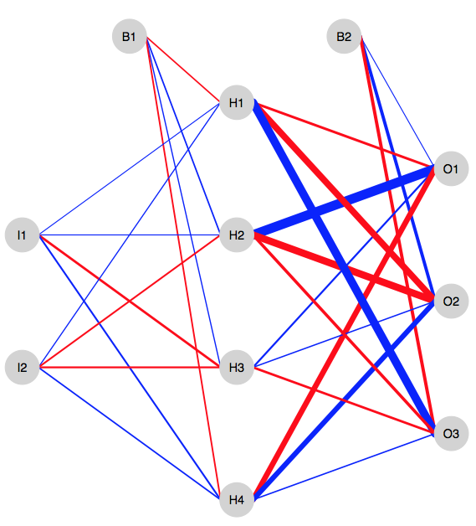
Prediction algorithms
Neural network
Neurons, connections
Weights adapted by
training examples
+ Similar to human brain
– Many parameters
– Unstable results
– Not guaranteed to converge

Slide 12
Combining algorithms
Stacked generalization
Meta-classifier: learns from the output of various models
Determines for each class the best linear combination of models
Can use ordinary linear regression, SVM regression
– Requires custom code in R
– Extremely slow training

Slide 13
Prediction accuracy
Model | Accuracy
Random Forest | 90.3%
Support Vector Machine | 86.8%
Neural network | 75.6%
Stack: ordinary least-squares | 90.3%
Stack: SVM regression | 90.3%
Random Forest makes most accurate predictions
Stacking does not help in our situation

Slide 14
DMC 2013 Competition
63 teams created predictions
Best accuracy = 97.2%
  160 features
  Average of 600 decision trees from bootstrap sample (bagging)
  C4.5 decision tree algorithm
Difference likely due to feature extraction

Slide 15
Limitations
Webserver log data is collected during visit
  But at end of visit, it may be too late to influence customer
  When using only customer data, accuracy drops from 90.3% to 69.2%
Accuracies may vary on other data sets

Slide 16
Principal Findings
Order prediction possible to large degree
Random Forest highly recommended
  Good accuracy
  Fast model
For prediction problems, simple imputation methods are sufficient
  Iterate quickly, adding new features
Stacking not useful in this regard
  Inflexible, no accuracy gain

Slide 17


Thank you for your attention!
lifeforms.nl/thesis

Slide 18

Questions and Comments
lifeforms.nl/thesis

